Slide 1
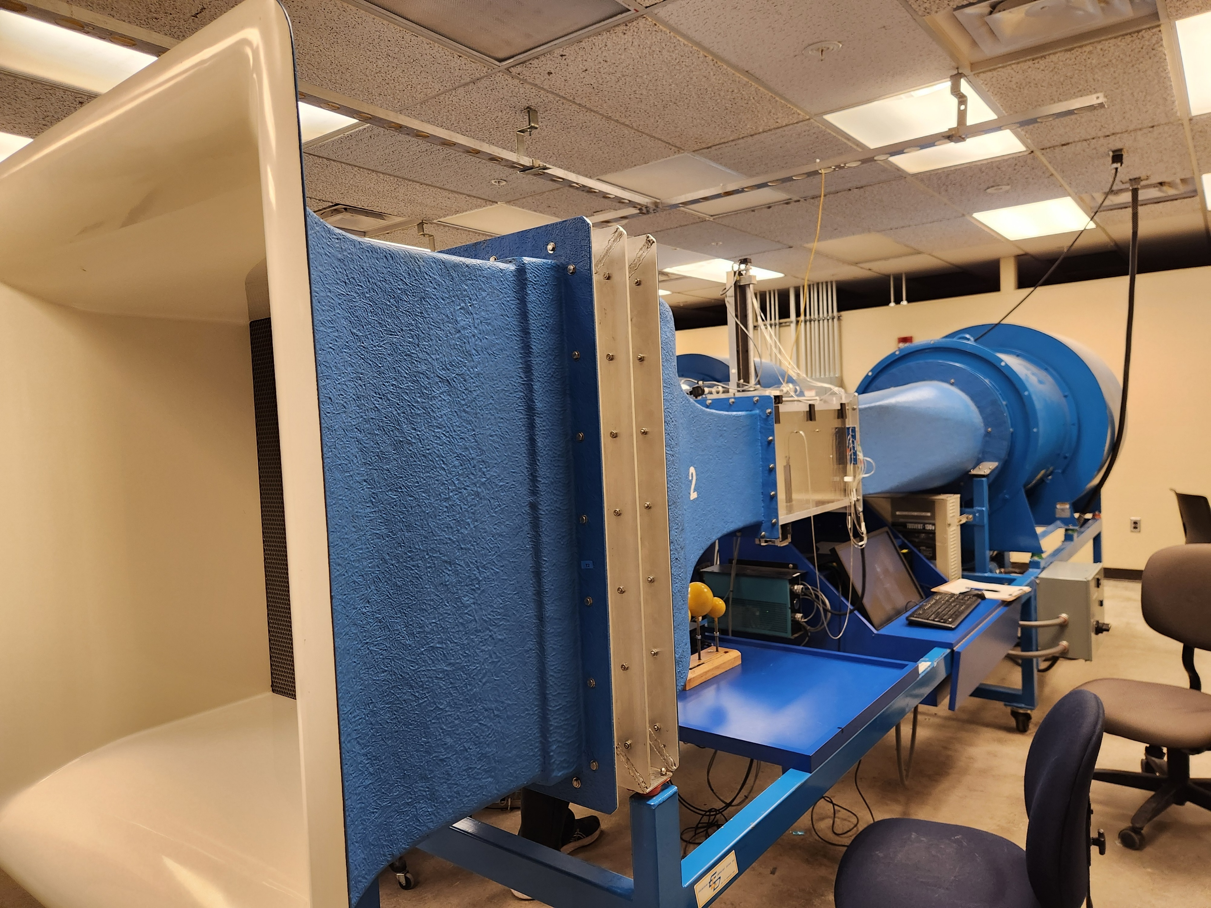
INLET
OUTLET
TEST SECTION
FLOW DIRECTION

Slide 2
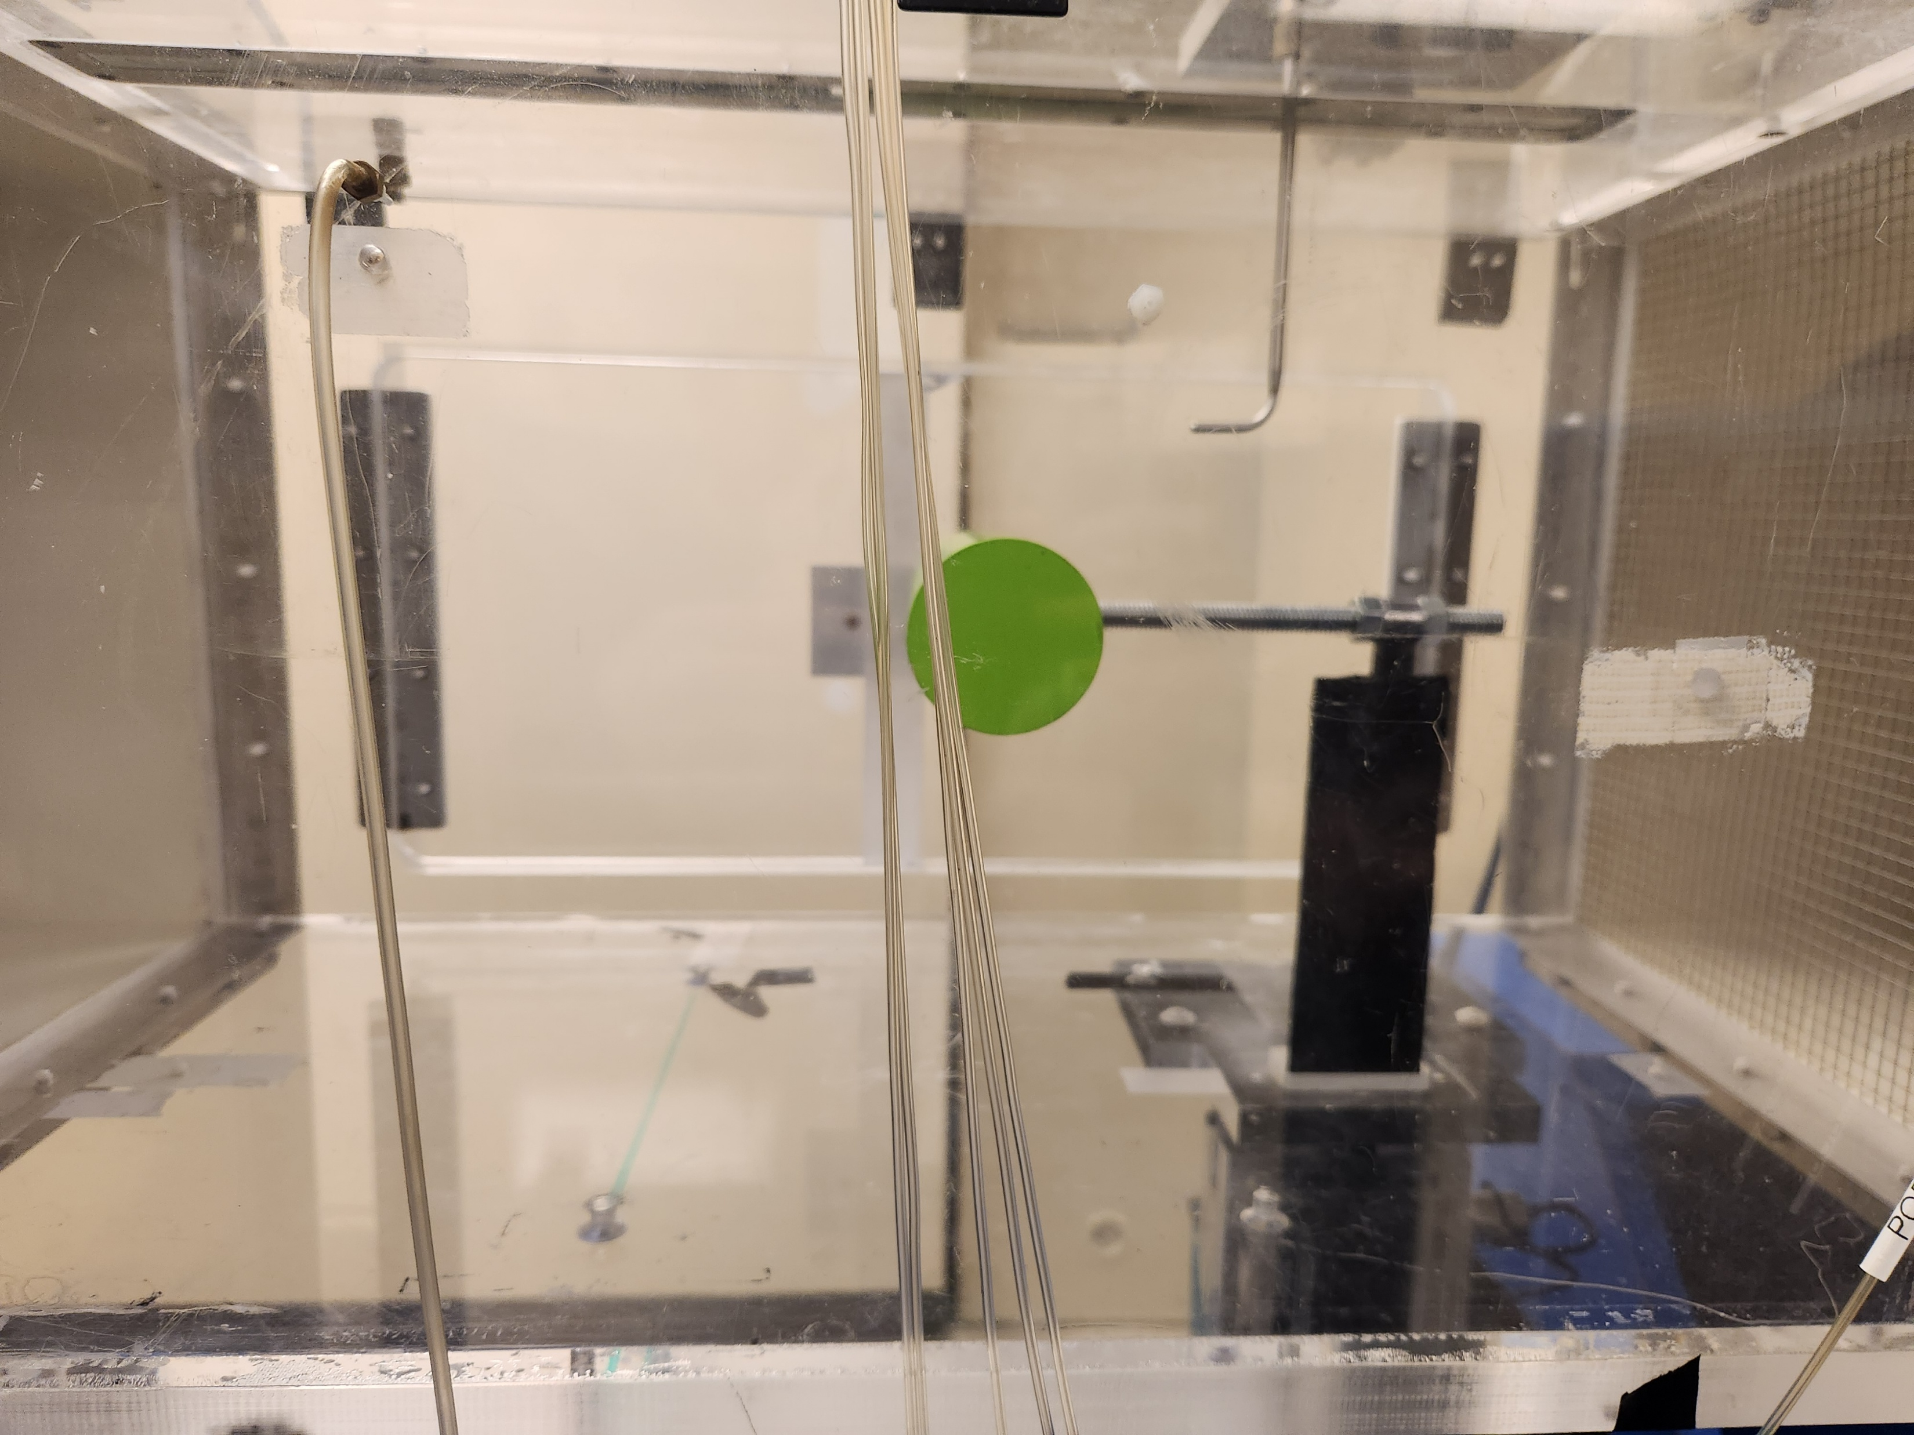
X Zero Location
Y Zero Location
(D+d)/2
3.25D

Slide 3
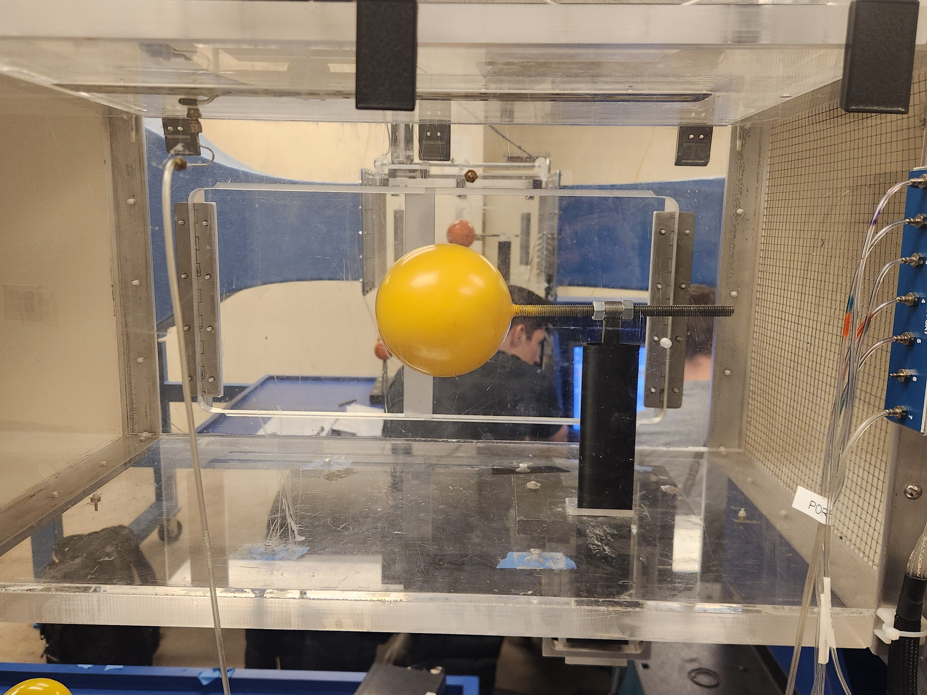
FLOW DIRECTION
D
Dynamometer

